Slide 1
Brewster Mews – 925 Robin Road, Amherst

Slide 2
Brewster Mews - Project Details
216 unit affordable multifamily apartments in 19 two-story buildings
100% Senior Tenancy (62+)
Built in 1978
14.8 acres, or 646,200 sq. ft. across two scattered sites
Unit Mix
198 One-Bedroom Units
17 Two-Bedroom Units
1 Two-Bedroom Employee Unit
Managed by MJ Peterson
Co-Ownership between MJ Peterson and Related

Slide 3
Brewster Mews – Proposed Rehabilitation
$58,000 per unit in total construction costs
$42 million in total development costs
Scope of Renovation includes new cabinets, counters, fixtures, appliances, lighting, tubs, toilets, flooring, doors, painting, electrical outlets, and signage. There will be upgrades to security lighting, cameras, monitoring equipment, and property access controls.
Renovation includes adaptation of 10 units to ADA compliance
Related will work with its Foundation and local non-profits to provide services to seniors including a Resident Services coordinator
Renovation will be in-place with only temporary relocation
A new clubhouse will include a computer lab and fitness room as well as have an addition added to accommodate office space for the on-site management team

Slide 4
Brewster Mews – Tax Incentives
Tax incentives required for financial viability of the project given the scope of rehabilitation
45% of materials sourced from Erie County
$6,000,000 will be subject to local sales & use tax
$525,000 sales tax benefit will be reinvested in the property and enable us to complete the scope of work which is needed
Rehabilitation will result in a 40-year extension of affordability restrictions at the property
Local labor requirements will be met and W/MBE outreach conducted

Slide 5
Brewster Mews – Community Building

Slide 6
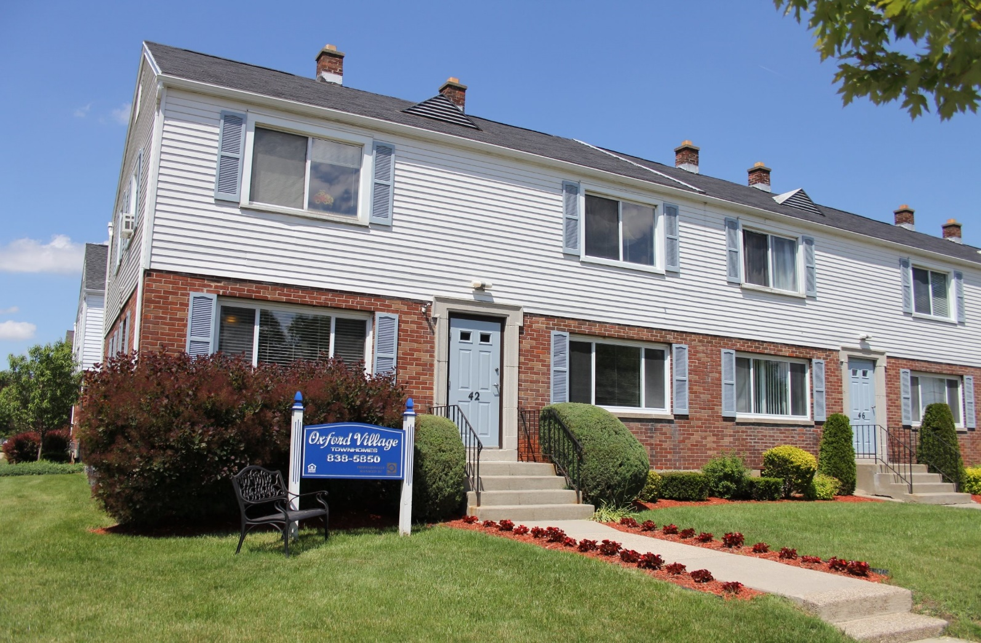
Oxford Village – 42 Oxford Avenue, Amherst

Slide 7
Oxford Village- Project Details
316 unit affordable multifamily apartments in 68 two-story buildings
Family Tenancy
Built in 1946; Last renovated in 1986
13.4 acres, or 582,100 sq. ft.
Unit Mix
313 Two-Bedroom Units
3 Two-Bedroom Employee Units
Managed by MJ Peterson
Co-Ownership between MJ Peterson and Related

Slide 8
Oxford Village– Proposed Rehabilitation
$60,000 per unit in total construction costs
$56 million in total development costs
Scope of Renovation includes new cabinets, counters, fixtures, appliances, lighting, tubs, toilets, flooring, doors, painting, and electrical outlets.
Site improvements include landscaping, railing and handrail replacements, parking lot and sidewalk repairs, and signage updates
Building system improvements include new roofs, façade repairs, replacement of all windows, and gas furnace and hot water heater upgrades. Security improvements will include upgraded lighting, security cameras, and monitoring equipment.
Renovation includes items requested by the Town of Amherst including improvements to landscaping, installation of playsets, activation of courtyards for resident use and signage
Related Foundation and local non-profits to provide services Renovation will be in-place with only temporary relocation

Slide 9
Oxford Village – Tax Incentives
Tax incentives required for financial viability of the project given the scope of rehabilitation
45% of materials sourced from Erie County
$10,500,000 will be subject to local sales & use tax
$918,750 sales tax benefit will be reinvested in the property and enable us to complete the scope of work which is needed
Rehabilitation will result in a 40-year extension of affordability restrictions at the property
Local labor requirements will be met and W/MBE outreach conducted

Slide 10
Oxford Village– Proposed Plantings

Slide 11
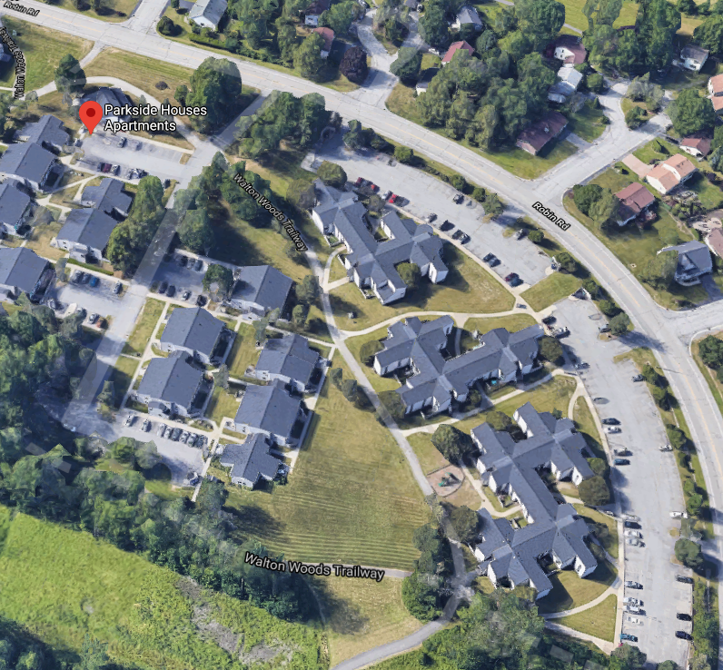
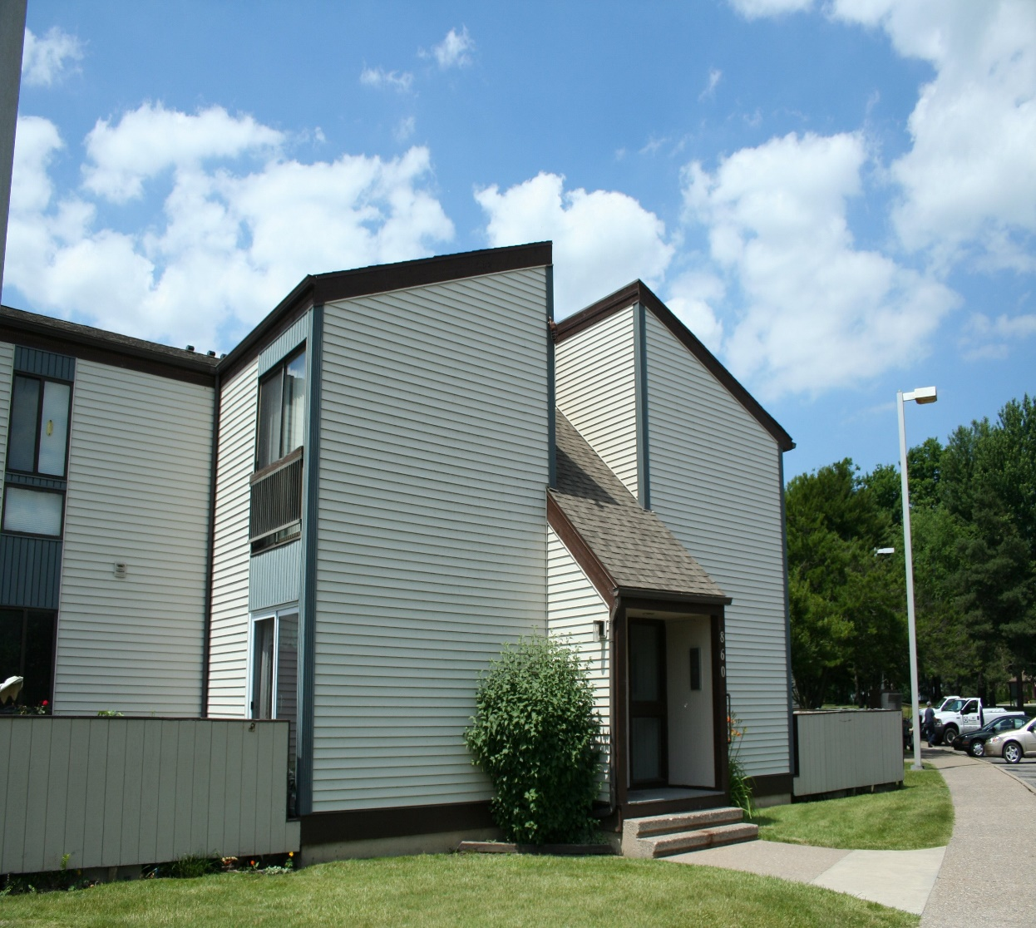
Parkside Houses – 925 Robin Road, Amherst

Slide 12
Parkside Houses - Project Details
180 unit affordable multifamily apartments in 33 buildings
Family Tenancy
Built in 1974
10.3 acres, or 448,700 sq. ft.
Unit Mix
44 One-Bedroom Units
78 Two-Bedroom Units
48 Three-Bedroom Units
10 Four-Bedroom Units
Managed by MJ Peterson
Co-Ownership between MJ Peterson and Related

Slide 13
Parkside Houses– Proposed Rehabilitation
$63,000 per unit in total construction costs
$29 million in total development costs
Scope of Renovation includes new cabinets, counters, sinks, fixtures, appliances, lighting, tubs, toilets, vanities, flooring, doors, painting, and electrical outlets
Site improvements include landscaping, asphalt paving, curbs and ramps, playground, and signage. Common areas would be modernized and upgraded. Security improvements will include upgraded lighting, security cameras and monitoring equipment and access controls.
Renovation includes adaptation of 9 units to ADA compliance
Related will work with its Foundation and local non-profits to provide services to seniors including a Resident Services coordinator
Renovation will be in-place with only temporary relocation
A new clubhouse will be built

Slide 14
Parkside Houses– Tax Incentives
Tax incentives required for financial viability of the project given the scope of rehabilitation
45% of materials sourced from Erie County
$6,500,000 will be subject to local sales & use tax
$568,750 sales tax benefit will be reinvested in the property and enable us to complete the scope of work which is needed
Rehabilitation will result in a 40-year extension of affordability restrictions at the property
Local labor requirements will be met and W/MBE outreach conducted

Slide 15
Parkside Houses – Community Building

Slide 16
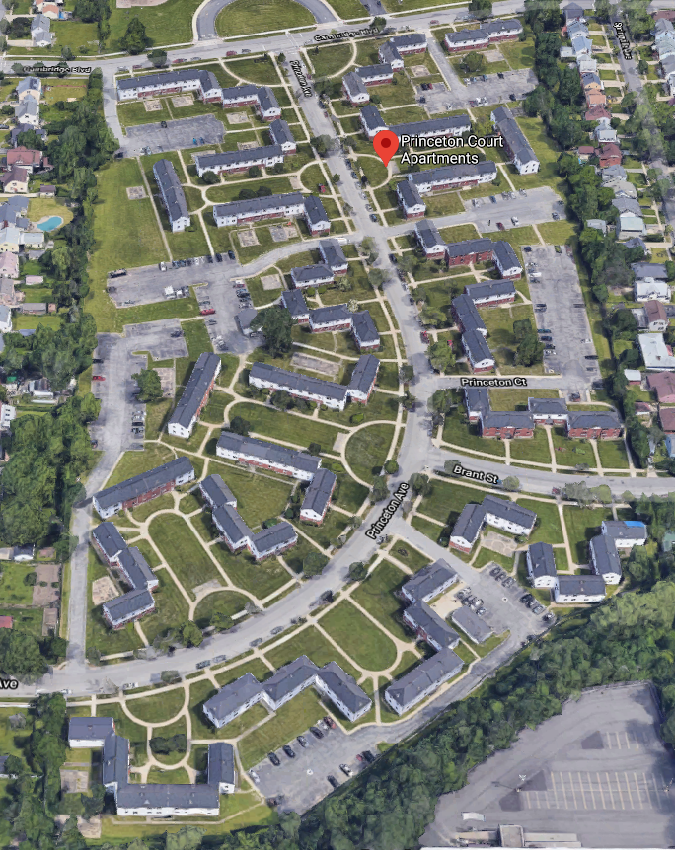
Princeton Court– 165 Princeton Ave, Amherst

Slide 17
Princeton Court- Project Details
304 unit affordable multifamily apartments in 76 buildings
Family Tenancy
Built in 1949
15.7 acres, or 684,800 sq. ft. across five scattered sites
Unit Mix
48 Studio Units
106 One-Bedroom Units
147 Two-Bedroom Units
3 Two-Bedroom Employee Units
Managed by MJ Peterson
Co-Ownership between MJ Peterson and Related

Slide 18
Princeton Court– Proposed Rehabilitation
$72,000 per unit in total construction costs
$47 million in total development costs
Scope of Renovation includes new cabinets, counters, fixtures, appliances, lighting, tubs, toilets, flooring, doors, painting, and electrical outlets.
Site improvements include landscaping, parking lot and sidewalk repairs, and signage updates. Security improvements will include upgraded lighting, security cameras and monitoring equipment and access controls.
Renovation includes adaptation of 16 units to ADA compliance
Building system improvements include new roofs, façade repairs, replacement of all windows, and gas furnace and hot water heater upgrades
Related will work with its Foundation and local non-profits to provide services to seniors including a Resident Services coordinator
Renovation will be in-place with only temporary relocation

Slide 19
Princeton Court– Proposed Rehabilitation
A new Community Building is to be built to include a community gathering space, fitness center and computer lab, along with additional office space to accommodate Management functions and on-site staff
Renovation includes items requested by the Town of Amherst including improvements to landscaping, installation of playsets, activation of courtyards for resident use, signage and development of vehicular fire access roadways

Slide 20
Princeton Court – Tax Incentives
Tax incentives required for financial viability of the project given the scope of rehabilitation
45% of materials sourced from Erie County
$11,000,000 will be subject to local sales & use tax
$962,500 sales tax benefit will be reinvested in the property and enable us to complete the scope of work which is needed
Rehabilitation will result in a 40-year extension of affordability restrictions at the property
Local labor requirements will be met and W/MBE outreach conducted

Slide 21
Princeton Court – Community Building

