Slide 1
BLAK
Notes:
March 15, I declared a State of Emergency in the Town of Amherst.
On April 6 I told our Emergency Services personnel that we needed to start an Economic Recovery Plan,
We are now working to build off of the efforts of our first three years to further reform Town Government, to create fiscal stability into the future and to change the Town’s Course to meet the demands of the New Economy.
We are using COVID-19 as a catalyst to improve every facit of Town Government and to emerge as a leading community in NYS and the nation!

Slide 2
Upstate NY’s Largest Town & 4th Largest Population
Upstate Populations
Buffalo
Rochester
Syracuse
Amherst
Albany
Notes:
Alright…. (crack knuckles) let’s start this thing up Amherst Style!!!
Start the clock now AJ?
Amherst is not just the largest WNY suburb, it’s the 4th largest municipality in Upstate NY and bigger than the City of Albany

Slide 3
129,595 Population
The Town of Amherst estimated daytime population swells to over 188,000, with more people commuting in than out on a regular basis. There are thousands of businesses, which call Amherst home and SUNY Buffalo has an Undergraduate enrollment of 21,921.
Notes:
………… Infact it is pretty impressive to think about our numbers….. 188K daytime population, thousands of businesses and the Undergraduate Campus for NY’s flagship University

Slide 4
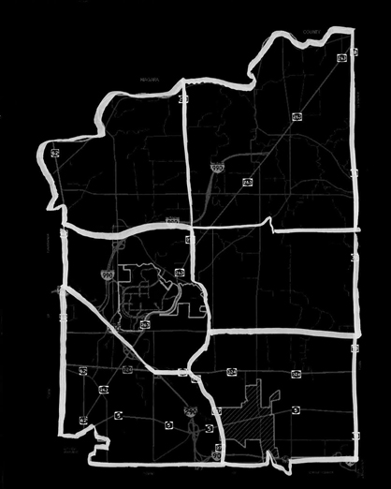
Boulevard District
Boulevard Mall Retrofit
District-wide Rezoning
UB Annex Redevelopment

Slide 5
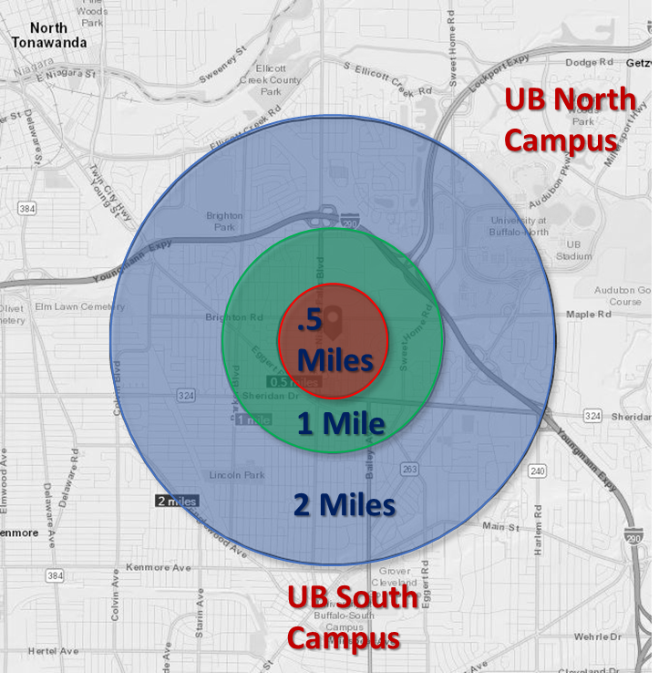
Boulevard Central District
“a chance to reimagine and redevelop one of its largest and most successful commercial areas in a comprehensive manner”
Notes:
With the second highest density in all of WNY, the Boulevard District lies halfway between UB’s North and South Campuses

Slide 6
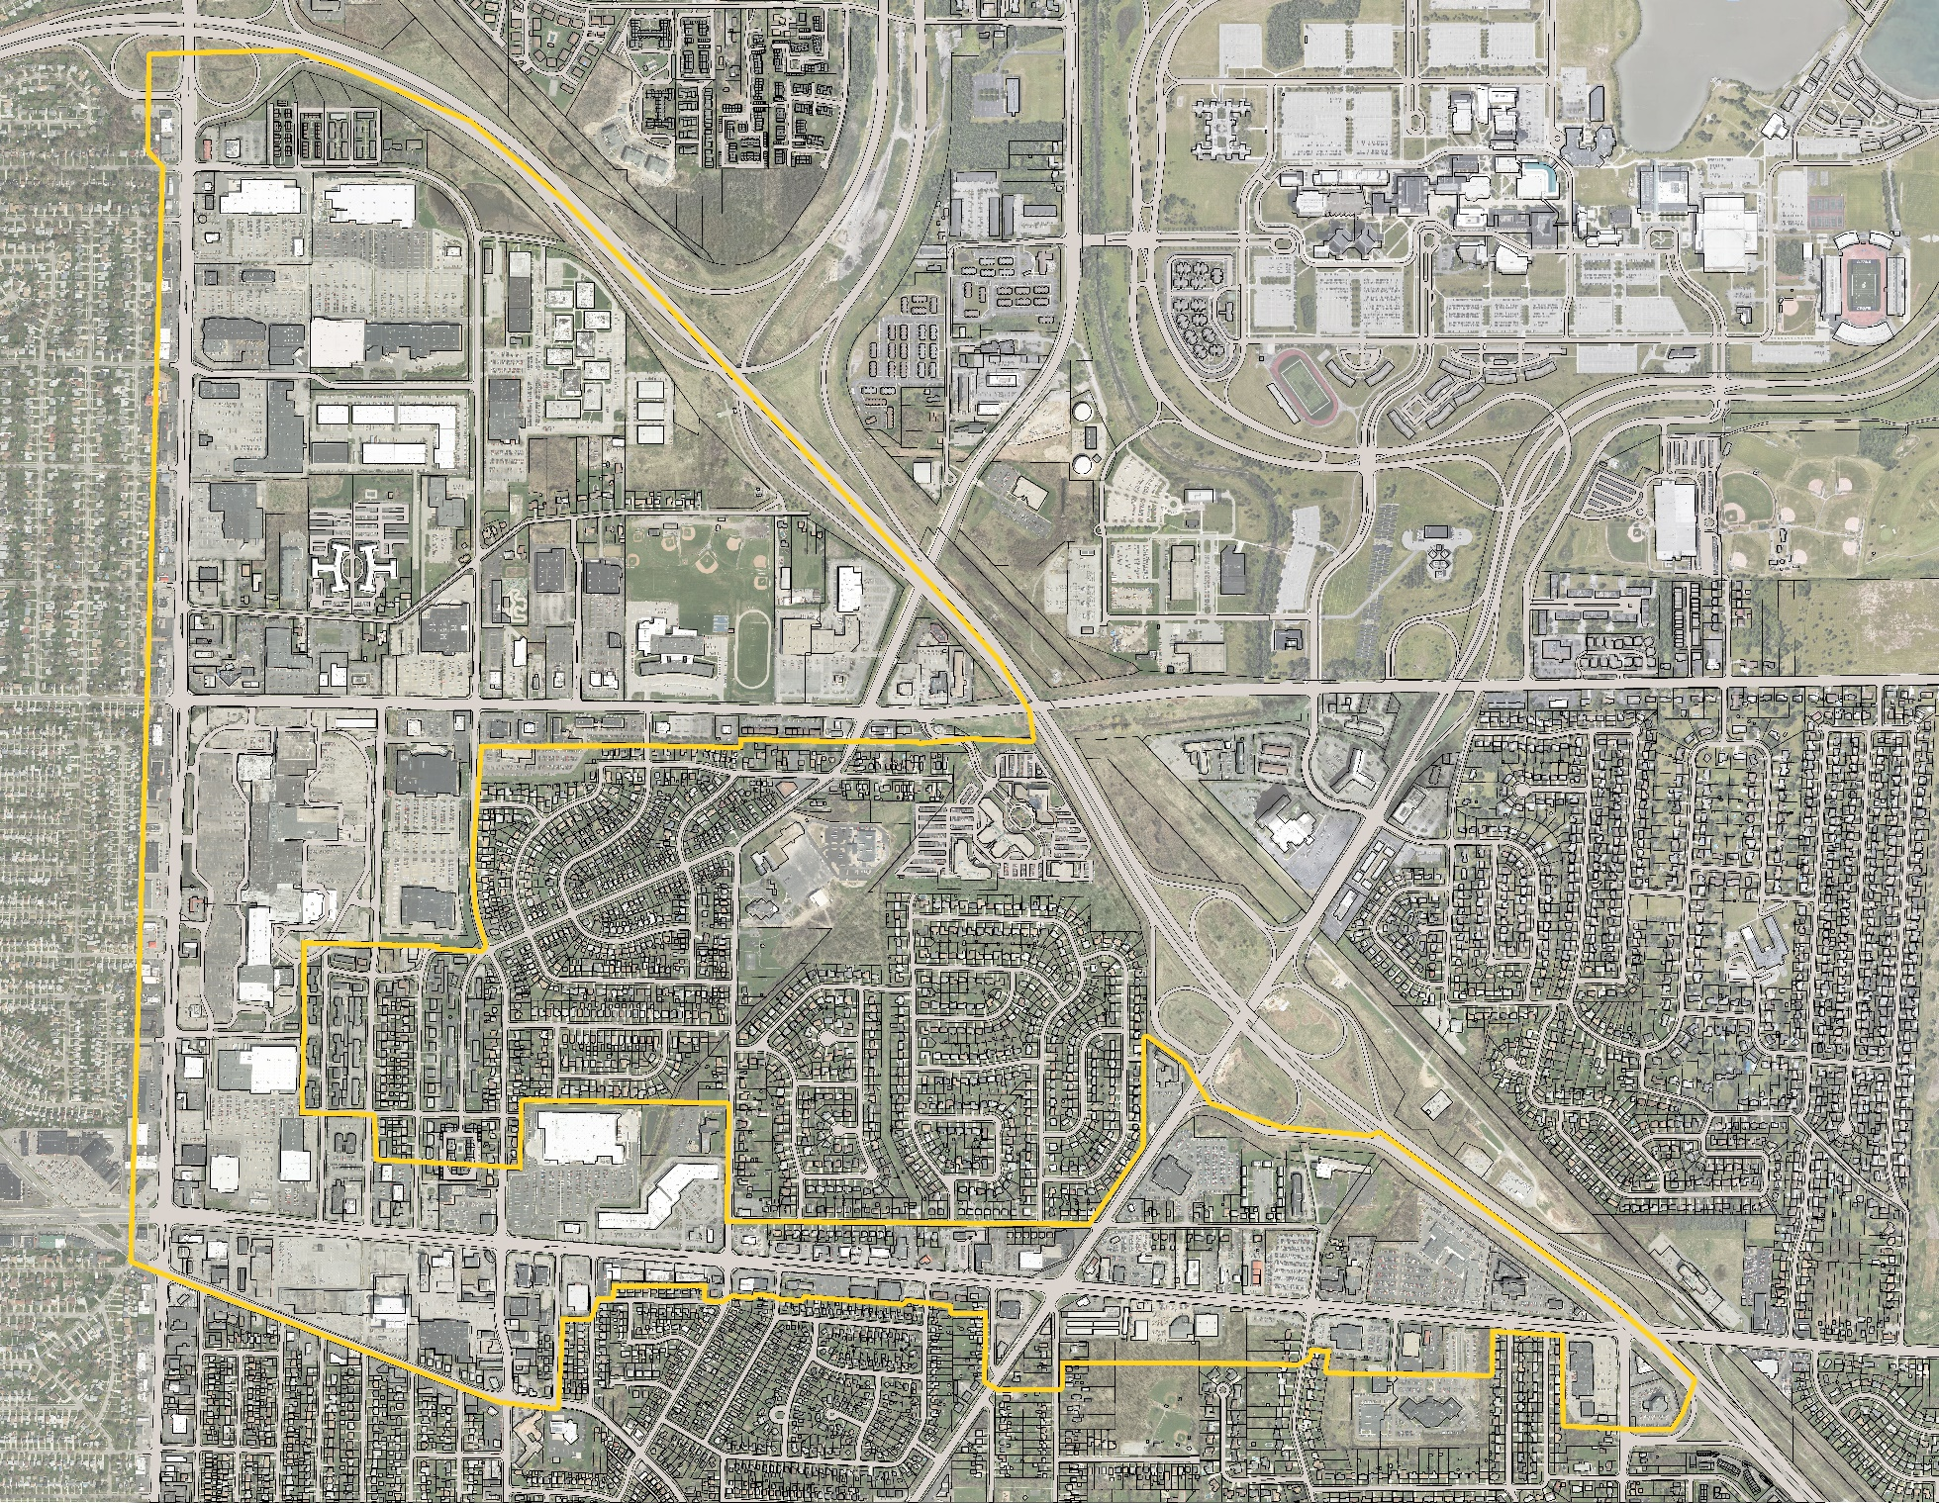
Sample sites: boulevard mall

Slide 7
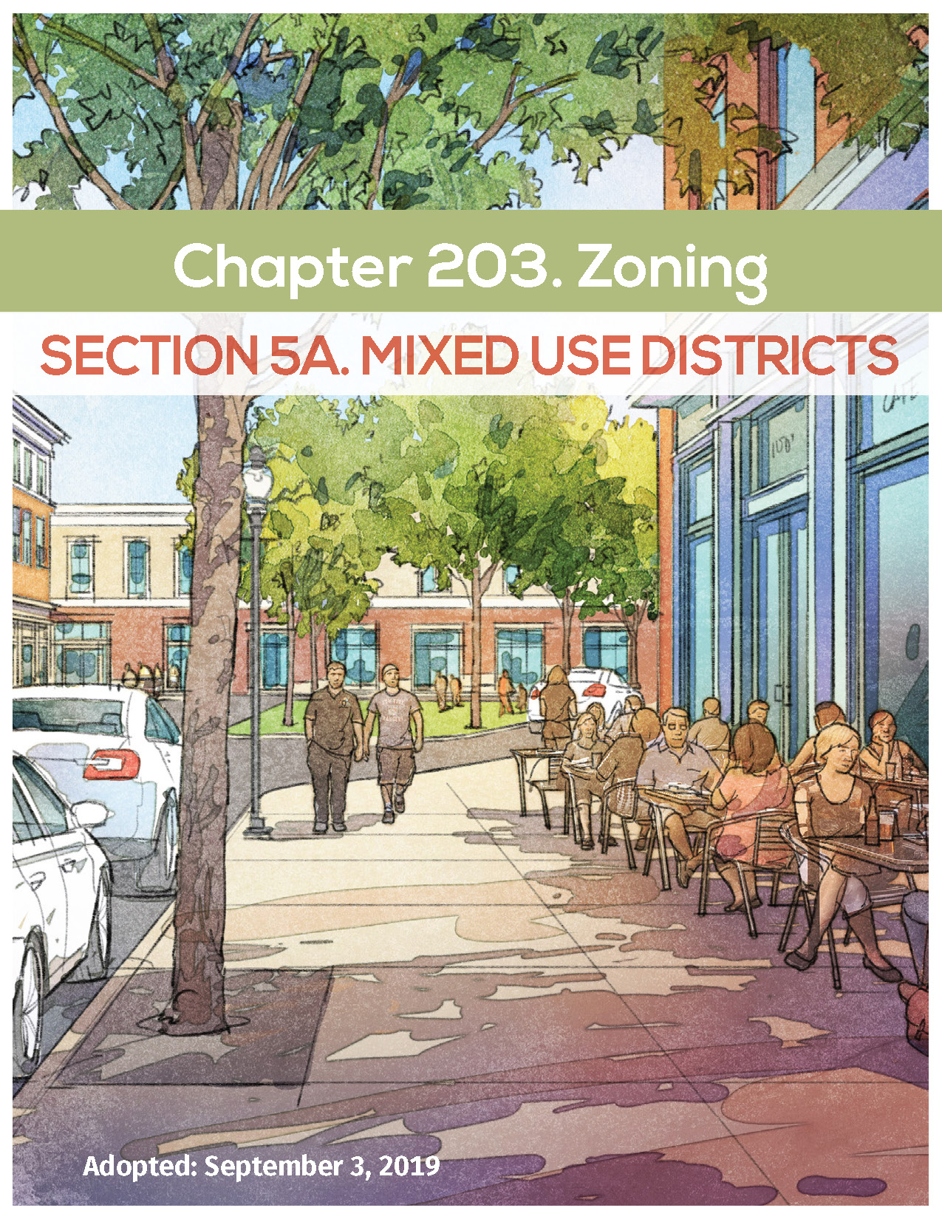
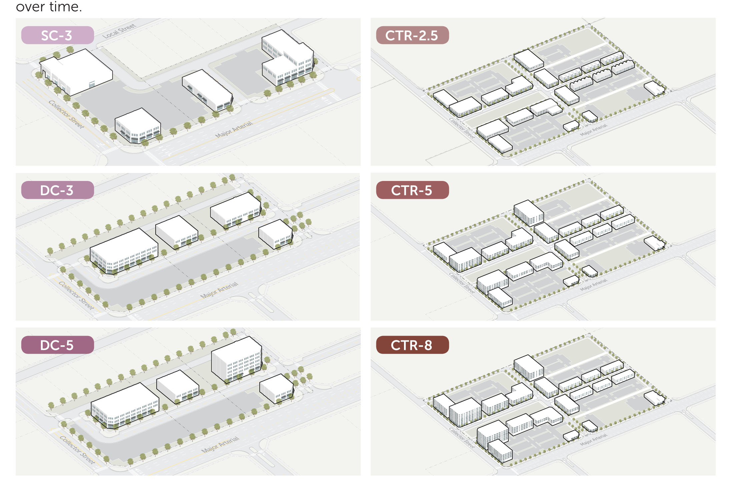
Mixed use districts code: retrofit

Slide 8
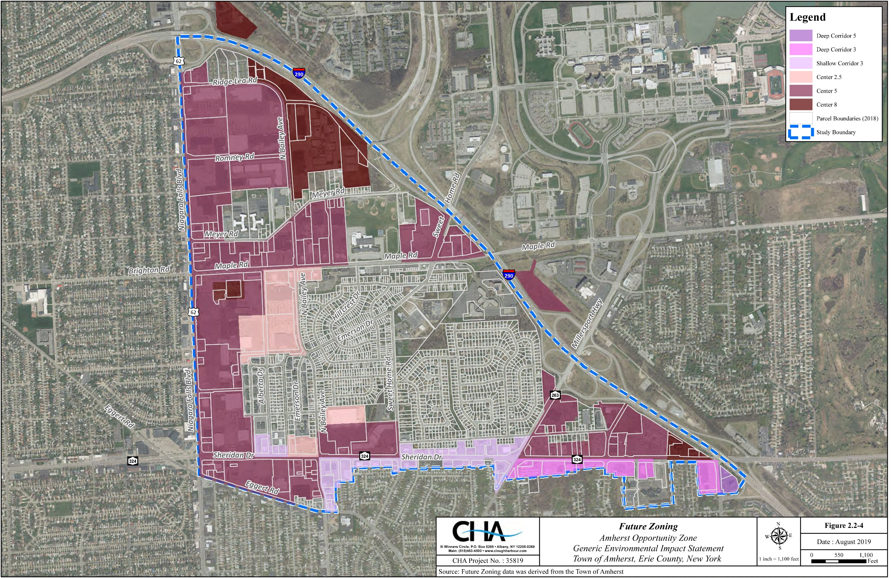
mapping the districts
Notes:
The entire area has been rezoned and we are working on projects at Sweethome and Maple, and………..

Slide 9
Boulevard Central District
“The goal is to encourage mixed-use development and increased density, maximize economic investment and tax revenue, improve mobility and pedestrian access via public transit, bicycling, and walkability, invest in aged infrastructure systems, and protect and enhance surrounding residential neighborhoods.”

Slide 10
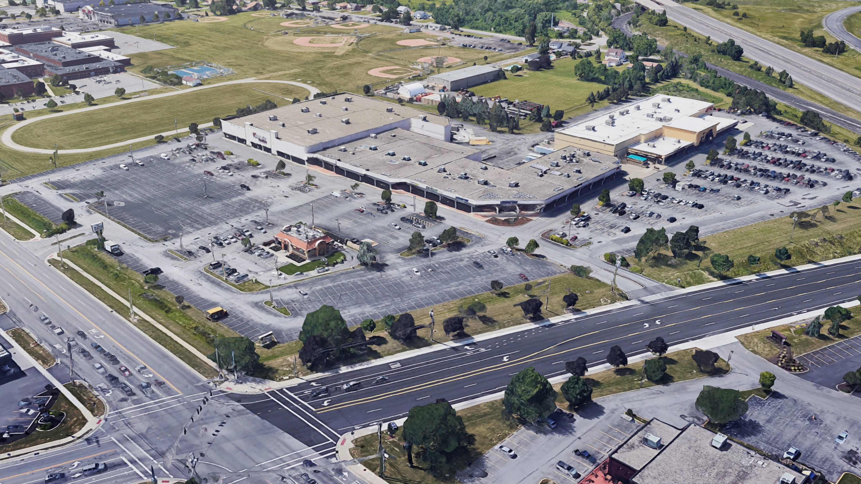

Slide 11
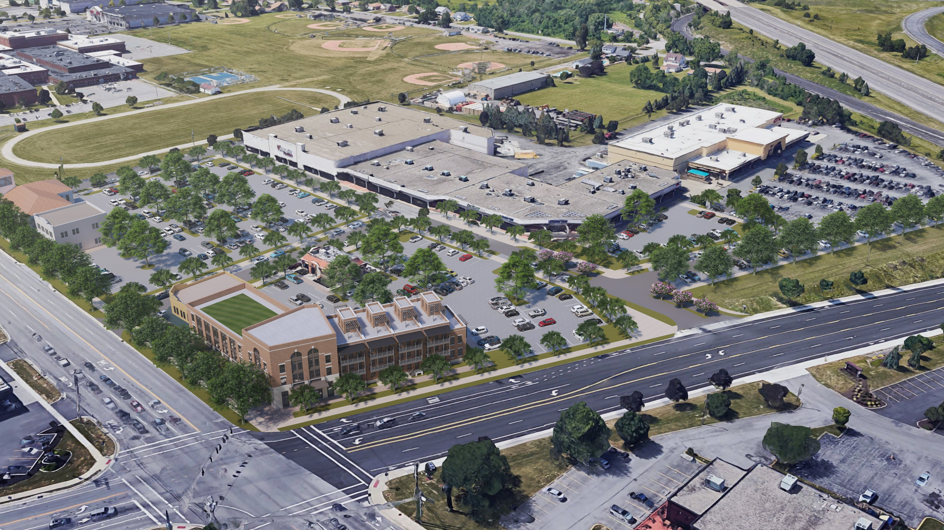

Slide 12
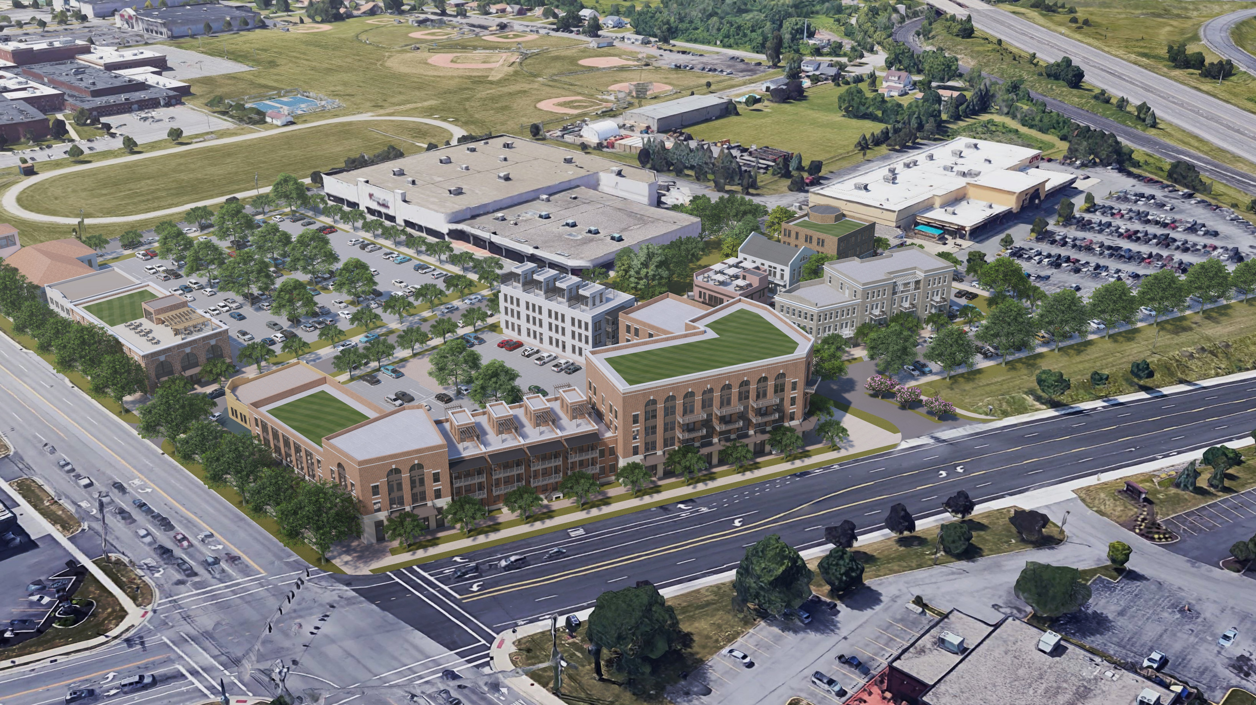

Slide 13
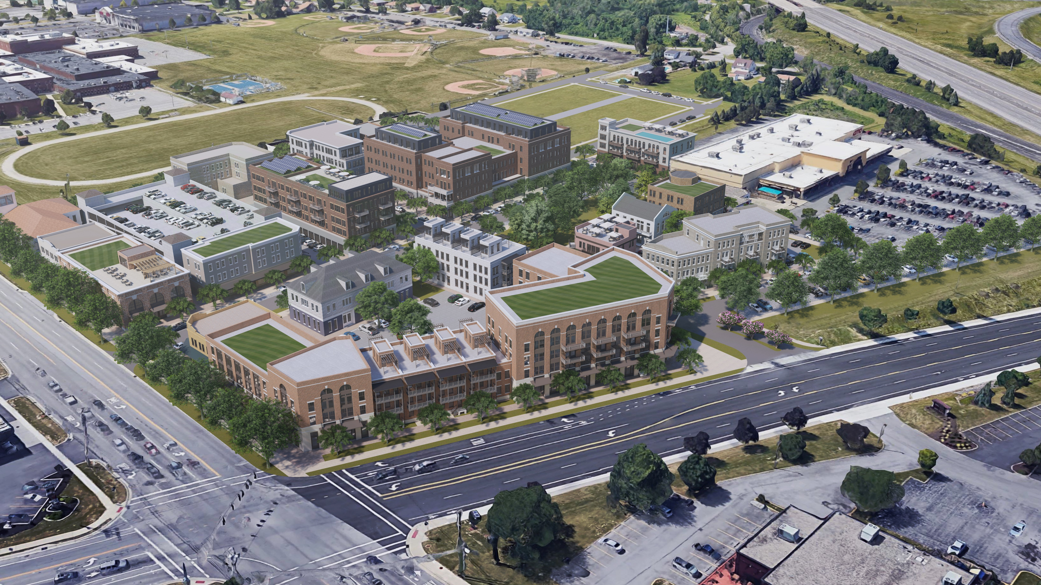

Slide 14
